Slide 1


Understanding
Asynchrony
Presented by Howie Reith
hreith@kr.af.mil
Mattermost: @Howie
Team: Marauder
https://github.com/howardreith/asyncPPT/

Slide 2



What is Asynchrony?
Imagine you’re an airline running a ticket counter with only one agent.
Most of the time things are fine, but sometimes things go wrong.
Customers forget their bags.
They need to consult with their families.
They can’t speak the agent’s language.
They’re confused and just really slow.

Slide 3

What is Asynchrony?
The longer things take, the more annoyed your customers become. What could you do? Maybe…
Hire more agents and open up more desks.
Have a separate baggage-check area.
Have a “simple queue” and a “complicated queue.”
Set a time limit for how long a customer has.
Obviously some of these will be received better by customers than others, but we can imagine how all of them might improve efficiency in for our airline.

Slide 4
What is Asynchrony?
Asynchrony concerns how we address these sorts of problems in computer programming. How does our software behave when things are slow?
In regard to web development, Javascript is a single-threaded language, which means it executes its processes synchronously, one after another. You cannot, out of the box, have two functions running at the same time.

Slide 5
Why is this a problem?
Like in our airport example, in the event anything goes wrong in our code, or something simply takes a long time, everything grinds to a halt. Common situations that cause such circumstances include:
Making calls to external APIs.
Waiting for user input.
Very long loops or recursive functions.
The setTimeout function.
Errors.

Slide 6
Why should I care?
Managing asynchrony is one of the single most challenging issues you’ll face in web development, and you’ll face it all the time.
Figuring out how to get your asynchronous behavior to occur in the order you want when you want in the way you want will be a never-ending struggle.
Solving these problems poorly will make your code run slowly and inefficiently, dragging out your tests and harming your users’ experiences of your work.
By knowing what’s going on behind the curtain, and knowing what tools to use when, you’ll save yourself and your users time and stress.

Slide 7
CPU vs. I/O Bound Code
When you Google asynchrony you’re going to encounter articles discussing two distinct issues – those concerning CPU limits and those concerning I/O issues.
CPU-bound issues concern “Can I make my code run faster by spreading the work out across multiple heads?” It’s about maximizing efficiency by recognizing processes that need not be run in order to operate correctly.
I/O-bound issues concern things you have to wait for – API calls, user inputs, etc. These issues cannot be improved by adding additional threads and, in fact, doing so will likely make your code run slower.
As web developers we are primarily concerned with I/O-bound issues, but for the sake of total comprehension we’ll touch briefly on multithreading.

Slide 8
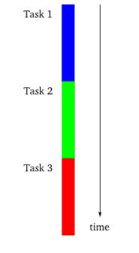
Multithreading – In Brief
Imagine you’re programming and you only have access to a single synchronous thread. In the event of an error, you want your users to be able to abort the process and move on. How can you give your users access to another “escape” process if your computer’s locked in a loop or an error?
Notes:
You’re tracking along and something goes wrong in Track 2, but your error handling is in Track 3. How do you get to it?

Slide 9
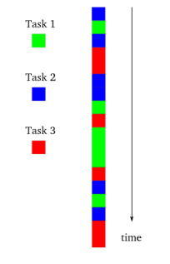
Multithreading – In Brief
What if you staggered your processes? “I’m going to work on thread 1 for a little while, then switch to thread 2, then back to thread 1, then thread 3…” etc. By alternating between threads you can avoid getting locked into any single problem-prone process.
Note that unless you actually encounter issues in your processes this arrangement is necessarily slower than a synchronously-run thread, since you must compute switching between the various processes.

Slide 10
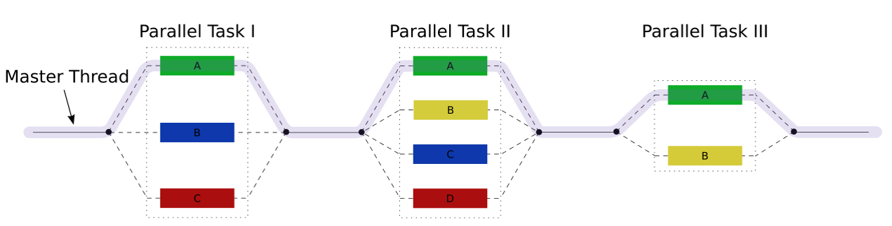
Multithreading – In Brief
If you have identified several processes in your code that do not depend on each other for completion, and you have multiple heads in your processor, you can divide the load between these heads and thereby improve efficiency in your code. If your processes are dependent on one another, your code may run slower than they otherwise would, as each process waits for its prerequisites to finish in the other heads.

Slide 11
Quiz
Which is faster – executing code synchronously or concurrently (multi-threaded)?

Slide 12
Javascript and the Browser
Javascript is a single-threaded language. You cannot run multiple concurrent processes in it, at least not out of the box, nor would you likely want to since most of our asynchrony problems are I/O bound.

Slide 13
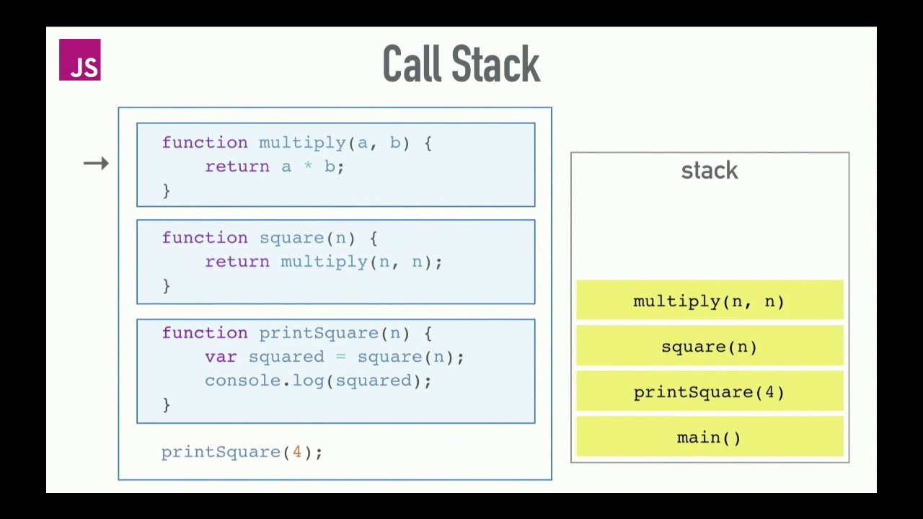
The Call Stack
To execute processes synchronously your browser uses what’s called the Call Stack.
A stack is last in, first out. Think of it like stacking plates. When you add a plate to a pile, you must remove the top plate before you’re able to remove additional plates.
Notes:
We call printSquare(4) and it gets added to the stack. printSquare() calls square(n), which gets added to the stack. Square() calls multiply(a, b) which gets added to the stack. Mulltiply returns which pops it off the stack and sends a value to square, which returns, pops off the stack, and sends a value to printSquare, which calls console.log() and prints the value of squared to the console.

Slide 14
The Event Loop
So how does your browser deal with asynchronous behavior if Javascript is single-threaded?
While Javascript is indeed single-threaded, it’s not the only resource available to your browser. Your browser has a variety of Web APIs at its disposal including the Document Object Model (DOM), ajax (xmlhttprequest), setTimeout, and more. These Web APIs allow an additional resource for handling asynchronous behavior.
Node also has APIs available, but C++ APIs rather than Web APIs.

Slide 15
Diving In - The Event Loop
console.log("Star");
setTimeout(function cb() {
console.log("A New Hope");
}, 2000);
console.log("Wars");
console.log(‘Star’) gets added to the call stack, executes, and ‘Star’ is added to the console.
setTimeout is added to the stack.
The browser starts a timer with a callback in its Web APIs.
console.log(‘Wars’) is added to the stack, is called, and adds ‘Wars’ to the console.
The timer completes and the callback is pushed into what’s called the “Task Queue”.
The Event Loop sees the callback in the Task Queue and pushes it into the stack.
console.log(‘A New Hope’) is popped off the stack and “A New Hope” is added to the console.
Notes:
Demonstrate this in the browser console then go through the steps.

Slide 16
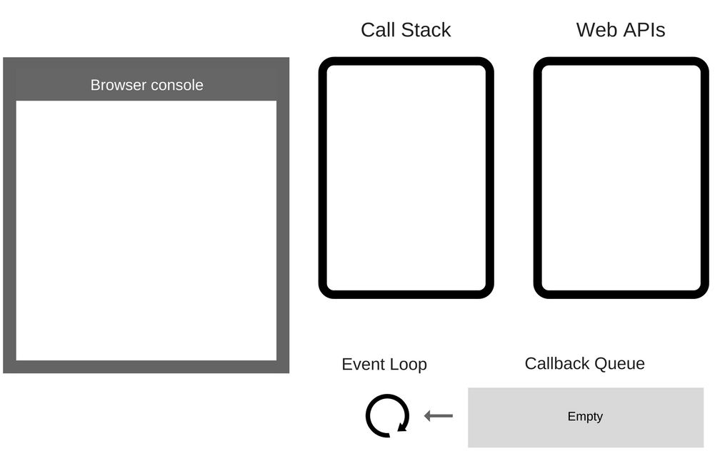
The Event Loop
console.log("Star");
setTimeout(function cb() {
console.log("A New Hope");
}, 2000);
console.log("Wars");
Notes:
Add some animated stuff here.

Slide 17
The Event Loop
“Star” Clog
Notes:
Add some animated stuff here.

Slide 18
The Event Loop
Star
Notes:
Add some animated stuff here.

Slide 19
The Event Loop
Star
setTimeout with callback
Notes:
Add some animated stuff here.

Slide 20
The Event Loop
Timer… ->
Callback
Star
Notes:
Add some animated stuff here.

Slide 21
The Event Loop
Timer… ->
Callback
Star
“Wars” Clog
Notes:
Add some animated stuff here.

Slide 22
The Event Loop
Timer… ->
Callback
Star
Wars
Notes:
Add some animated stuff here.

Slide 23
The Event Loop
Timer Done!
Star
Wars
Callback
Notes:
Add some animated stuff here.

Slide 24
The Event Loop
Star
Wars
Oh hey! There is something in the queue and the stack is empty!
Callback
Notes:
Add some animated stuff here.

Slide 25
The Event Loop
Star
Wars
Callback
Notes:
Add some animated stuff here.

Slide 26
The Event Loop
Star
Wars
A New Hope
Notes:
Add some animated stuff here.

Slide 27
The Event Loop
console.log("The Beginning");
fetch("https://jsonplaceholder.typicode.com/posts/1") .then(response => response.json())
.then(json => console.log(json))
console.log("There be latin coming!");

Slide 28
Quiz
setTimeout(function cb() {
console.log("The Empire");
}, 0);
console.log("Strikes");
console.log("Back");
In what order will these texts appear in the console? Why?
Notes:
Strikes – Back – The Empire. The Empire needs to go through the queue and get shoved back onto the stack after the other two console logs have gone through. As such, it goes last, even though setTmieout is set to 0.

Slide 29
Handling Async with Callbacks
function getSomething (callback) {
setTimeout(() => {
callback ({ text: 'this will appear second' }) }, 2000)}
getSomething(thing => {
console.log(thing.text)})
console.log("this will appear first")
The simplest way to handle asynchronous behavior is with callbacks. getSomething accepts a callback which is invoked by setTimeout, added to the queue, and when the stack is empty, the event loop pushes it back onto the stack which executes it.
Notes:
getSomething accepts a callback. This callback is invoked in setTimeout, which sets its timer and pushes the callback onto the queue. When the stack is empty, the event loop looks at the queue, pushes the callback onto the stack, and the console.log is executed.

Slide 30
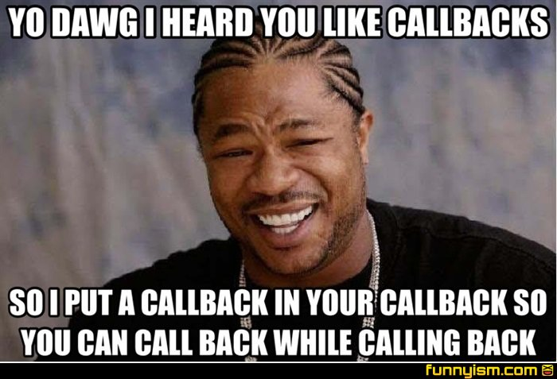
Handling Async with Callbacks
Callbacks are a fine way to deal with asynchronous behavior except for when you have an async call that’s contingent on another. The only solution is to put one callback inside of another, which can lead to “Callback Hell.”
Example
http://callbackhell.com/
Notes:
https://blog.hellojs.org/asynchronous-javascript-from-callback-hell-to-async-and-await-9b9ceb63c8e8

Slide 31
Handling Async with Callbacks
Callbacks also required that you handle your errors in every single callback, which can get a bit messy-looking.

Slide 32
Promises
Promises are a feature introduced in ES6.
When you build your asynchronous function you return a “new Promise,” which calls the constructor on the Promise class.
This constructor is expecting to get the asynchronous function we’re running as an argument.
It also expects a function that describes behavior for an error.
When we invoke the function we wrote, we can chain “.then” after we return. Each .then receives the return value of the previous. This allows us to handle several async calls without callback hell.
“.catch” is used to address all of the error handling.

Slide 33
Promises
function getSomething() {
return new Promise((resolve, reject) => {
setTimeout(() => {
let error = false;
if(!error) resolve({ text: "this will appear second" })
else reject() }, 2000)
})}
getSomething().then(thing => {
console.log(thing.text)})
.catch(error => {
console.log("Error occurred")
})
console.log("this will appear first");
Notes:
We define getSomething. It returns a new Promise that accepts the asynchronous resolution or an error function.

Slide 34
Promises
We can chain .then and the second will wait for the response from the first, allowing us to make its call contingent on the response of the first if we like. Our .catch also handles all errors, unlike was the case with callbacks.
fetch("https://jsonplaceholder.typicode.com/posts/1")
.then(response => {
return response.json()})
.then(response => response.id)
.then(response => {
const newId = response + 1
return fetch("https://jsonplaceholder.typicode.com/posts/" + newId)})
.then(response => {return response.json()})
.then(response => console.log(response))
.catch(function (error) {console.error(error);
}
);

Slide 35
Promise.all
Sometimes you’ll be in a situation where you have multiple promises and want to wait until they all resolve. In this case, we can employ the Promise.all method. Pass all of the promises in as arguments and the return value will be an array of their resolutions.
const promise1 = Promise.resolve(3);
const promise2 = new Promise(function(resolve, reject) { setTimeout(resolve, 200, "I am quickly resolved");
});
const promise3 = new Promise(function(resolve, reject) { setTimeout(resolve, 2000, "I take a while");
});
Promise.all([promise1, promise2, promise3])
.then(function(values) { console.log(values);});

Slide 36
Promises – no Try/Catch
While the error handling of Promises may remind you of Try/Catch, it’s important that you do not use Try/Catch with Promises. Doing so will provoke an unhandled exception warning:
UnhandledPromiseRejectionWarning: Unhandled promise rejection DeprecationWarning: Unhandled promise rejections are deprecated. In the future, promise rejections that are not handled will terminate the Node.js process with a non-zero exit code.

Slide 37
Quiz
How do you handle errors in promises?
Notes:
You use a single .catch after your .then(s). You do not use a try/catch.

Slide 38
Async Await
Async Await is a feature introduced in ES7 and Node 7.6.
Async is used for declaring functions that will handle asynchronous operations.
Await is used to declare we want to wait for the result of an async operation within an async function.
A function can only have the “await” keyword if it is actually “awaitable,” that is to say, it returns a Promise the likes of which we just discussed.
Functions with the await keyword are interchangeable with functions that resolve promises.

Slide 39
Async Await
const getSomething = () => {
return new Promise((resolve, reject) => {
setTimeout(() => {
let error = false;
if(!error) resolve({ text: 'You got the thing' })
else reject() }, 2000)})}
async function fetchSomething () {
try { const thing = await getSomething()
return thing }
catch (error) { console.log("Error occurred") }}
fetchSomething()
.then(thing => console.log(thing.text))
.catch((error) => console.error(error))
We are now using fetchSomething, an async function.
It awaits getSomething which returns a Promise.
We store our promise in “thing.”
With async await, we can surround it with a try catch to do our error handling.

Slide 40
Async Await
const getSomething = () => {
return new Promise((resolve, reject) => {
setTimeout(() => {
let error = false;
if(!error) resolve({ text: 'You got the thing' })
else reject() }, 2000)})}
async function fetchSomething () {
try { const thing = await getSomething()
return thing }
catch (error) { console.log("Error occurred") }}
const theResult = await fetchSomething()
console.log(theResult.text)

Slide 41
Async Await
async function fetchSomething(){ return await fetch("https://jsonplaceholder.typicode.com/posts/1"); }
async function getSomeStuff(){ try { const thing= await fetchSomething();
return (thing.json()) } catch(error){ console.error(error) } }
console.log(await getSomeStuff())

Slide 42
Async Await
Async Await is essentially syntactical sugar built around Promises to help it look more synchronous and thus easier to read.
The primary benefit of each of these options is aesthetic. All of them compile to the same code and none are more efficient from the computer’s perspective than any other.

Slide 43
Quiz
In what situation(s) would you consider using a callback?
In what situation(s) would you use Promises and .then?
In what situation(s) would you use Async Await?

Slide 44
Q&A

Slide 45
Resources
https://medium.com/codebuddies/getting-to-know-asynchronous-javascript-callbacks-promises-and-async-await-17e0673281ee
http://callbackhell.com/
https://developer.mozilla.org/en-US/docs/Web/JavaScript/Reference/Global_Objects/Promise
https://blog.risingstack.com/asynchronous-javascript/
https://blog.risingstack.com/node-js-at-scale-understanding-node-js-event-loop/
https://codingthesmartway.com/async-programming-with-javascript-callbacks-promises-and-async-await/
https://www.youtube.com/watch?v=8aGhZQkoFbQ

Slide 46
Contact
Howie Reith
hreith@kr.af.mil
@howie in Mattermost
Marauder

Slide 47
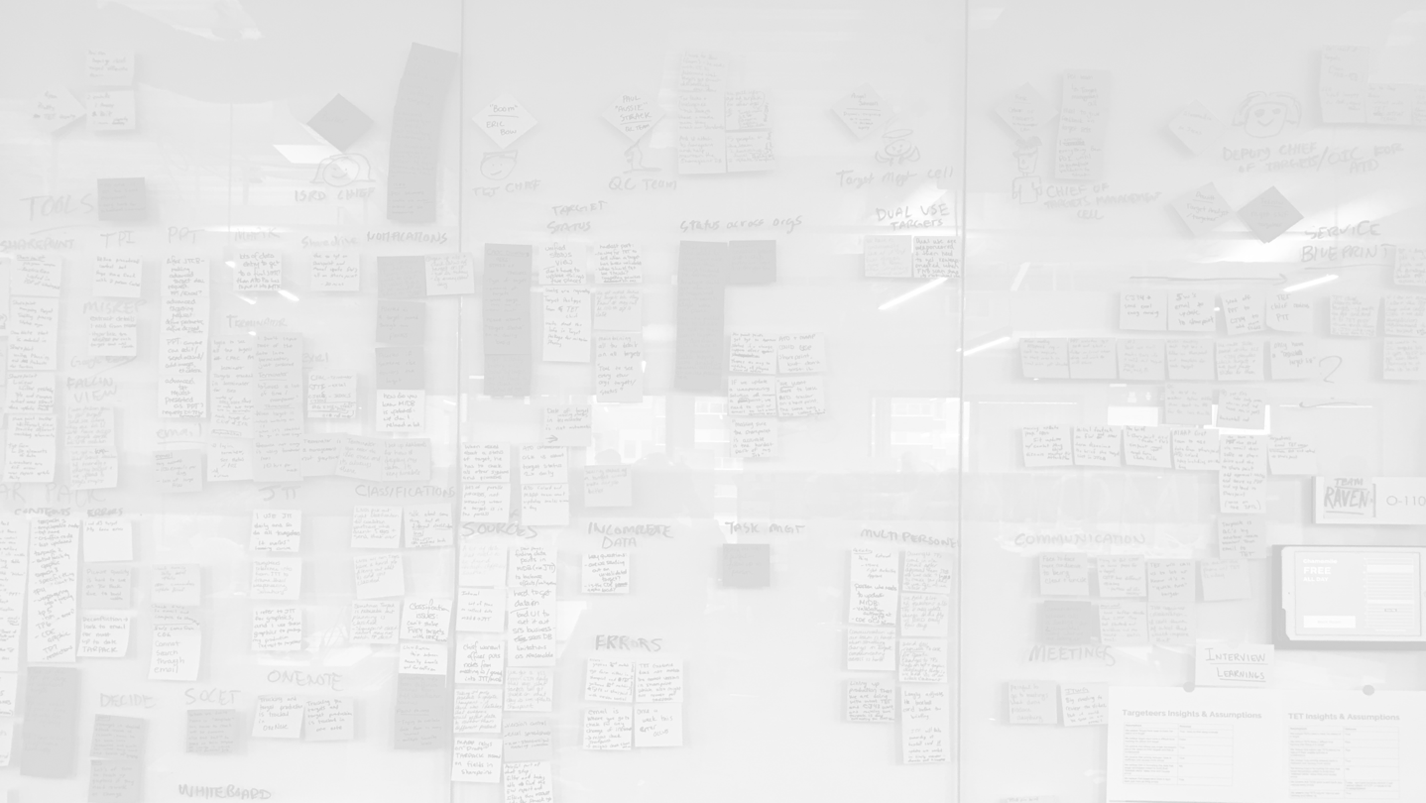
Join the Alliance!
https://kesselrun.af.mil
Code. Deploy. Win.

